Slide 1

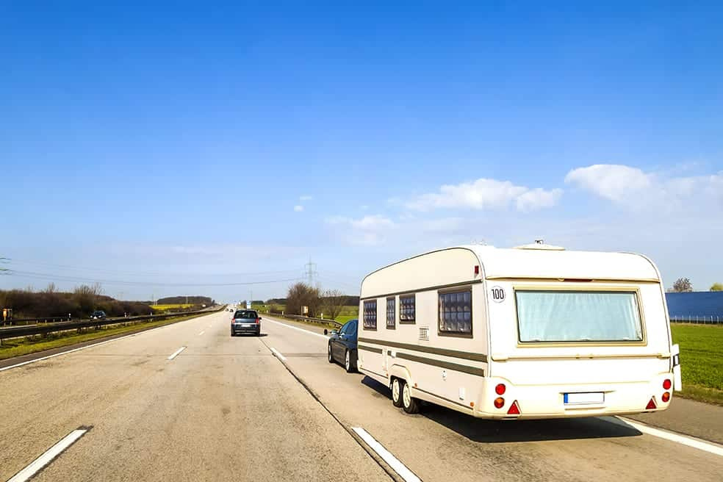
CARAVAN
INSURANCE
GROUP 23
ELDHOSE VARGHESE(6793260)
LAURA MÉNDEZ DEL PINO(6831762)
DIVYADHARSHINI SUNDARAM(6829352)
NANA KWADJO AWUAH NKANSAH(6781043)

Slide 2
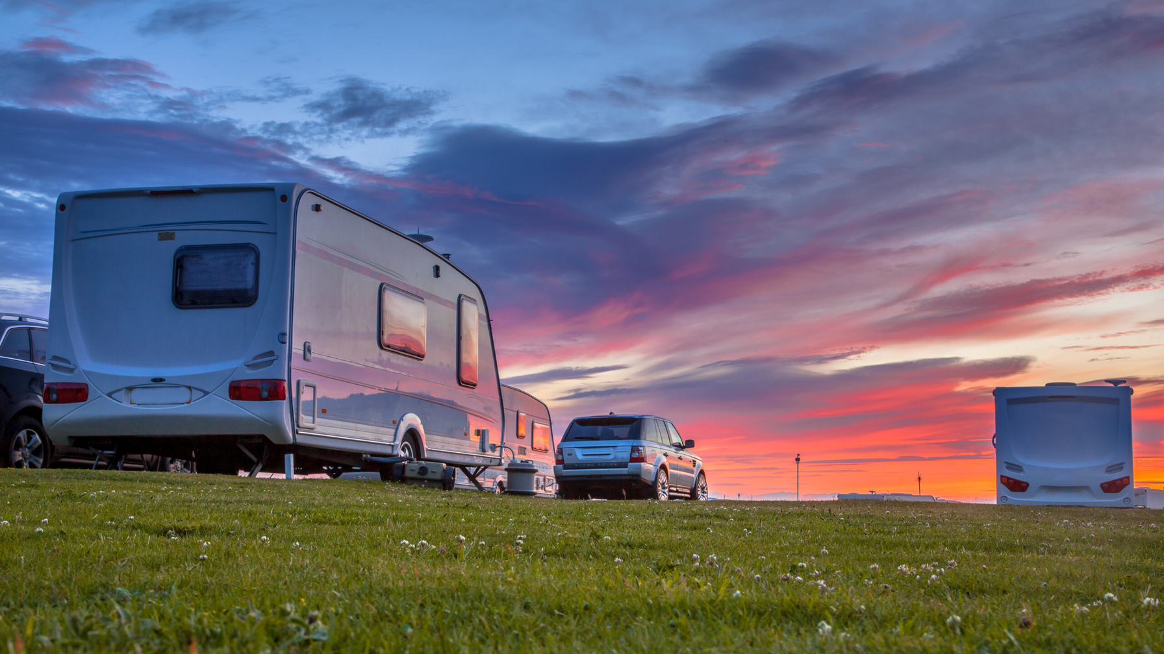
INTRODUCTION - CARAVAN INSURANCE
The insurance policy known as "Caravan insurance," provides customers with comprehensive coverage to protect their funds in the event of theft or damage to their caravan.

Slide 3



BACKGROUND OF THE STUDY
Predict if a customer is interested in a Caravan Insurance policy.
Identify the profile of a typical caravan insurance buyer.
AIM
Source : Dutch Data Mining Company - Sentinel Machine Research.
Total Records : 9822, Training Data: 5822 & Test Data: 4000.
86 attributes: 43 socio-demographic, 43 ownership of other insurance policies.
DATA

Slide 4




TASK 1: KNOWLEDGE DISCOVERY PROCESS IN DATABASES (KDD)
Problem Specification
Resourcing
Data Cleansing
Data Pre-processing
Data Mining
Evaluation
Interpretation
Exploitation

Slide 5

TASK 1: KDD APPLIED
Problem Specification
Resourcing
Data Cleansing
Data Pre-processing
Define the project's aim.
Create a plan.
Gain familiarity with the data.
Collect the necessary data.
Get familiar with the software.
Rename column headers.
Combine tables (MySQL).
Balance the data (SPSS and R).
Feature selection.
Data Mining
Evaluation
Interpretation
Exploitation
C5, Random Trees and C&RT (SPSS).
Logistics Regression (R).
S
Confusion metrics
Calculate ROI
How well the pattern corresponds with the present understanding
Apply gained knowledge into predicting the caravan insurance buyer.

Slide 6
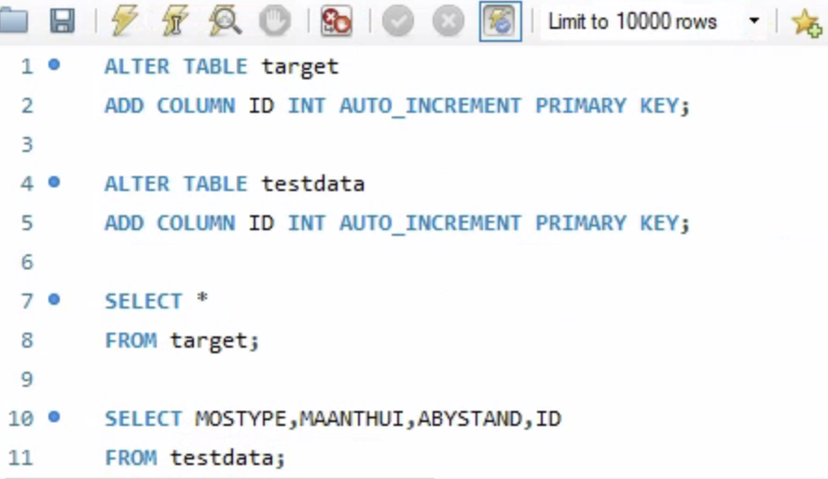
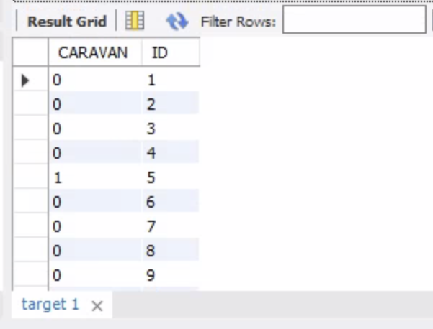
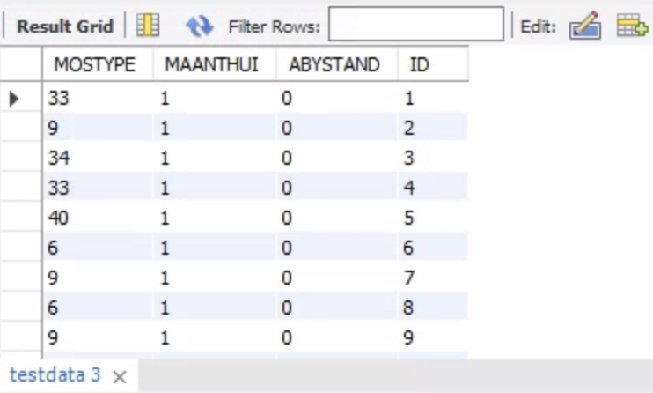

TASK 2 : DATABASES Q1 & Q2

Slide 7
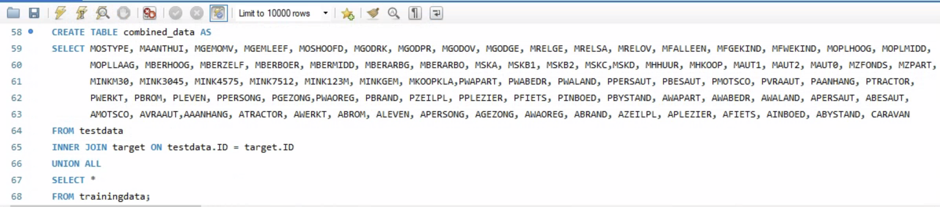
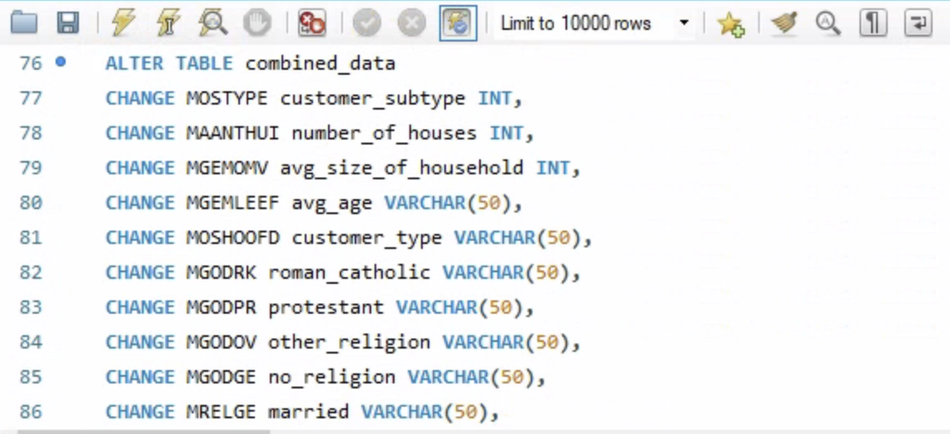
TASK 2 : DATABASES Q1 & Q2 CONTINUED
Combining test, target and training
Renaming the columns

Slide 8
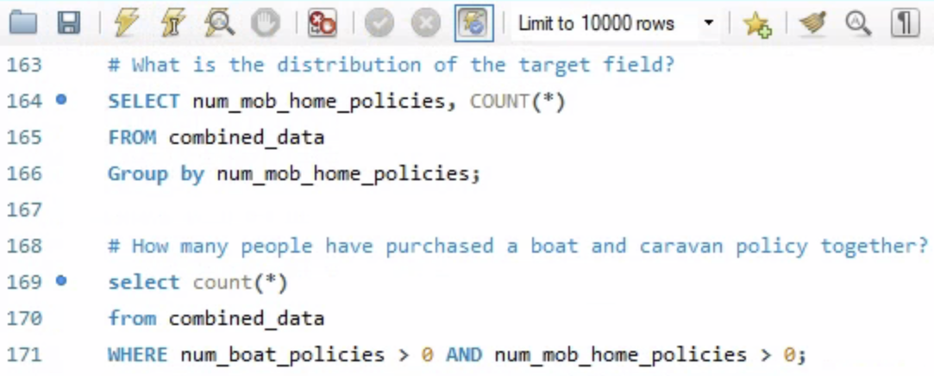
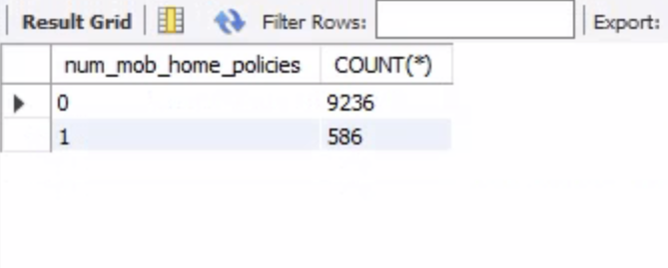
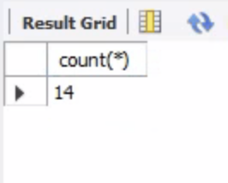
TASK 2 : DATABASES Q3 & Q4

Slide 9



DATA VISUALIZATION
01
Essential correlations with target
02
Key influencers diagram
03
Histograms

Slide 10
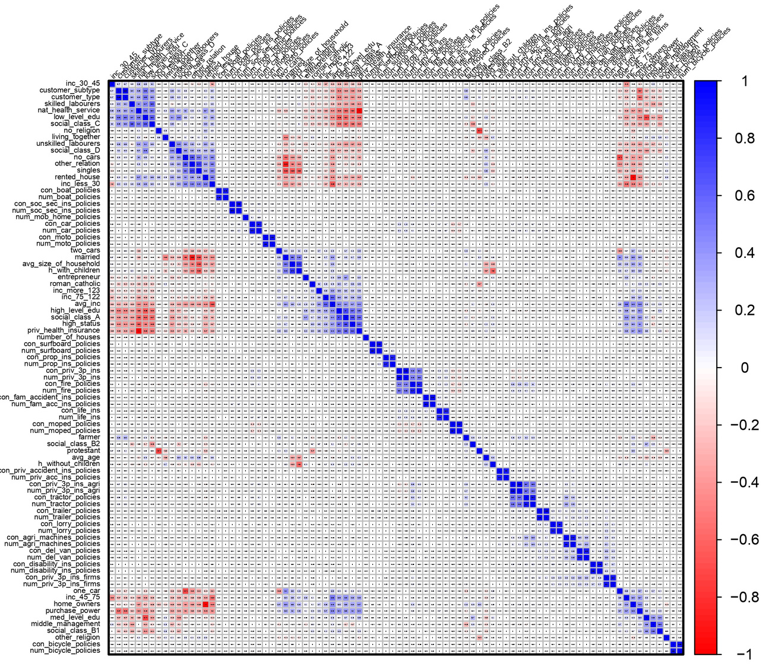
CORRELATION HEATMAP

Slide 11
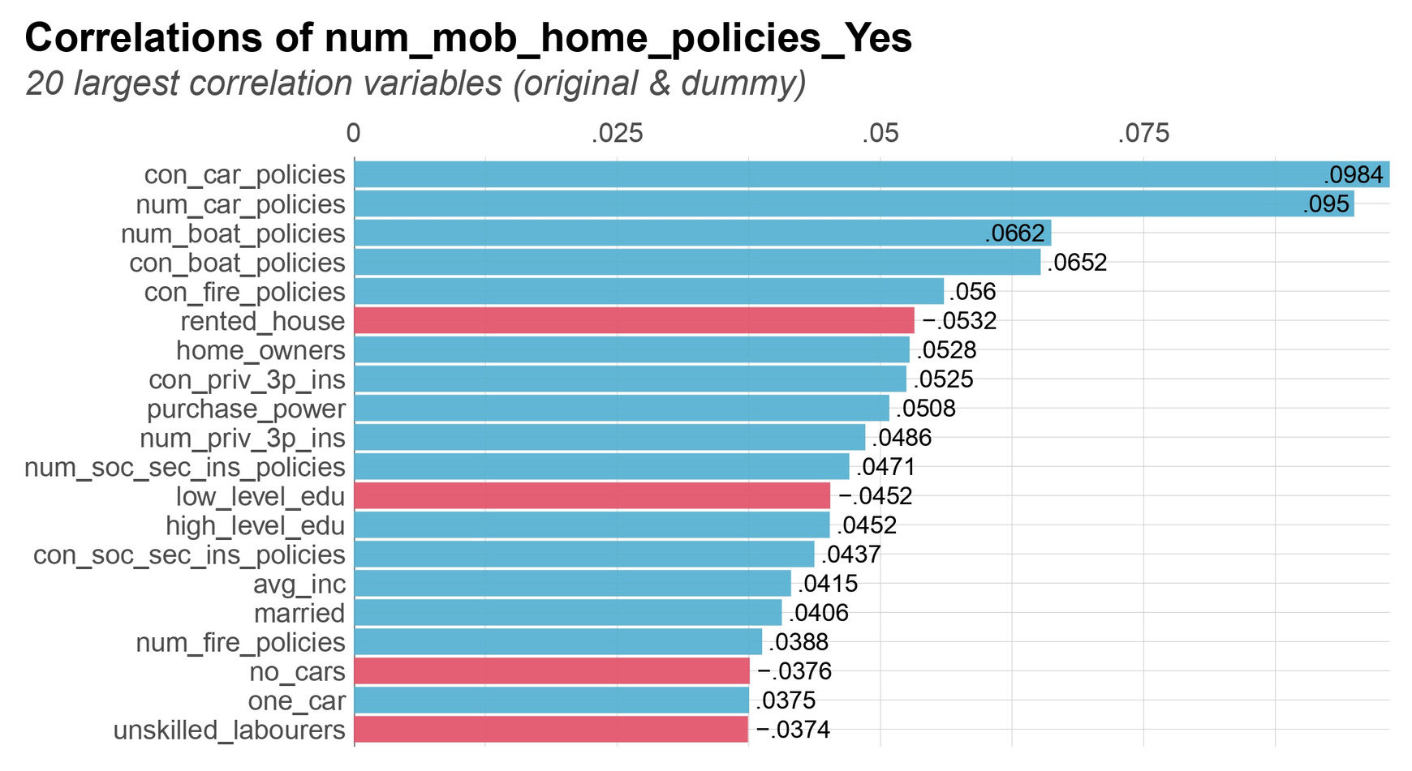
TOP 20 CORRELATION

Slide 12
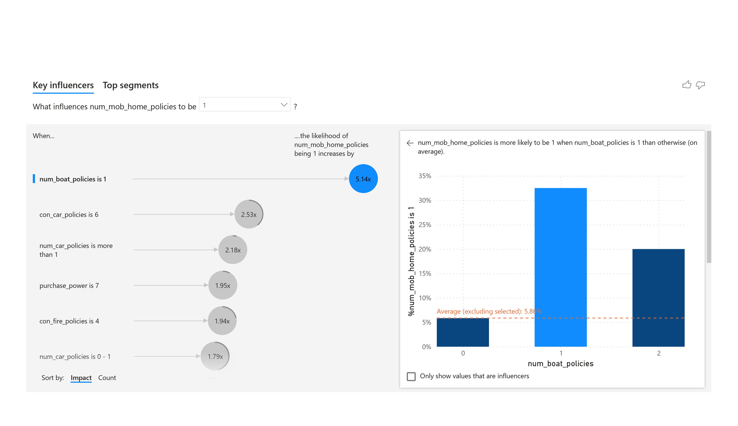
KEY INFLUENCER DIAGRAM 1

Slide 13
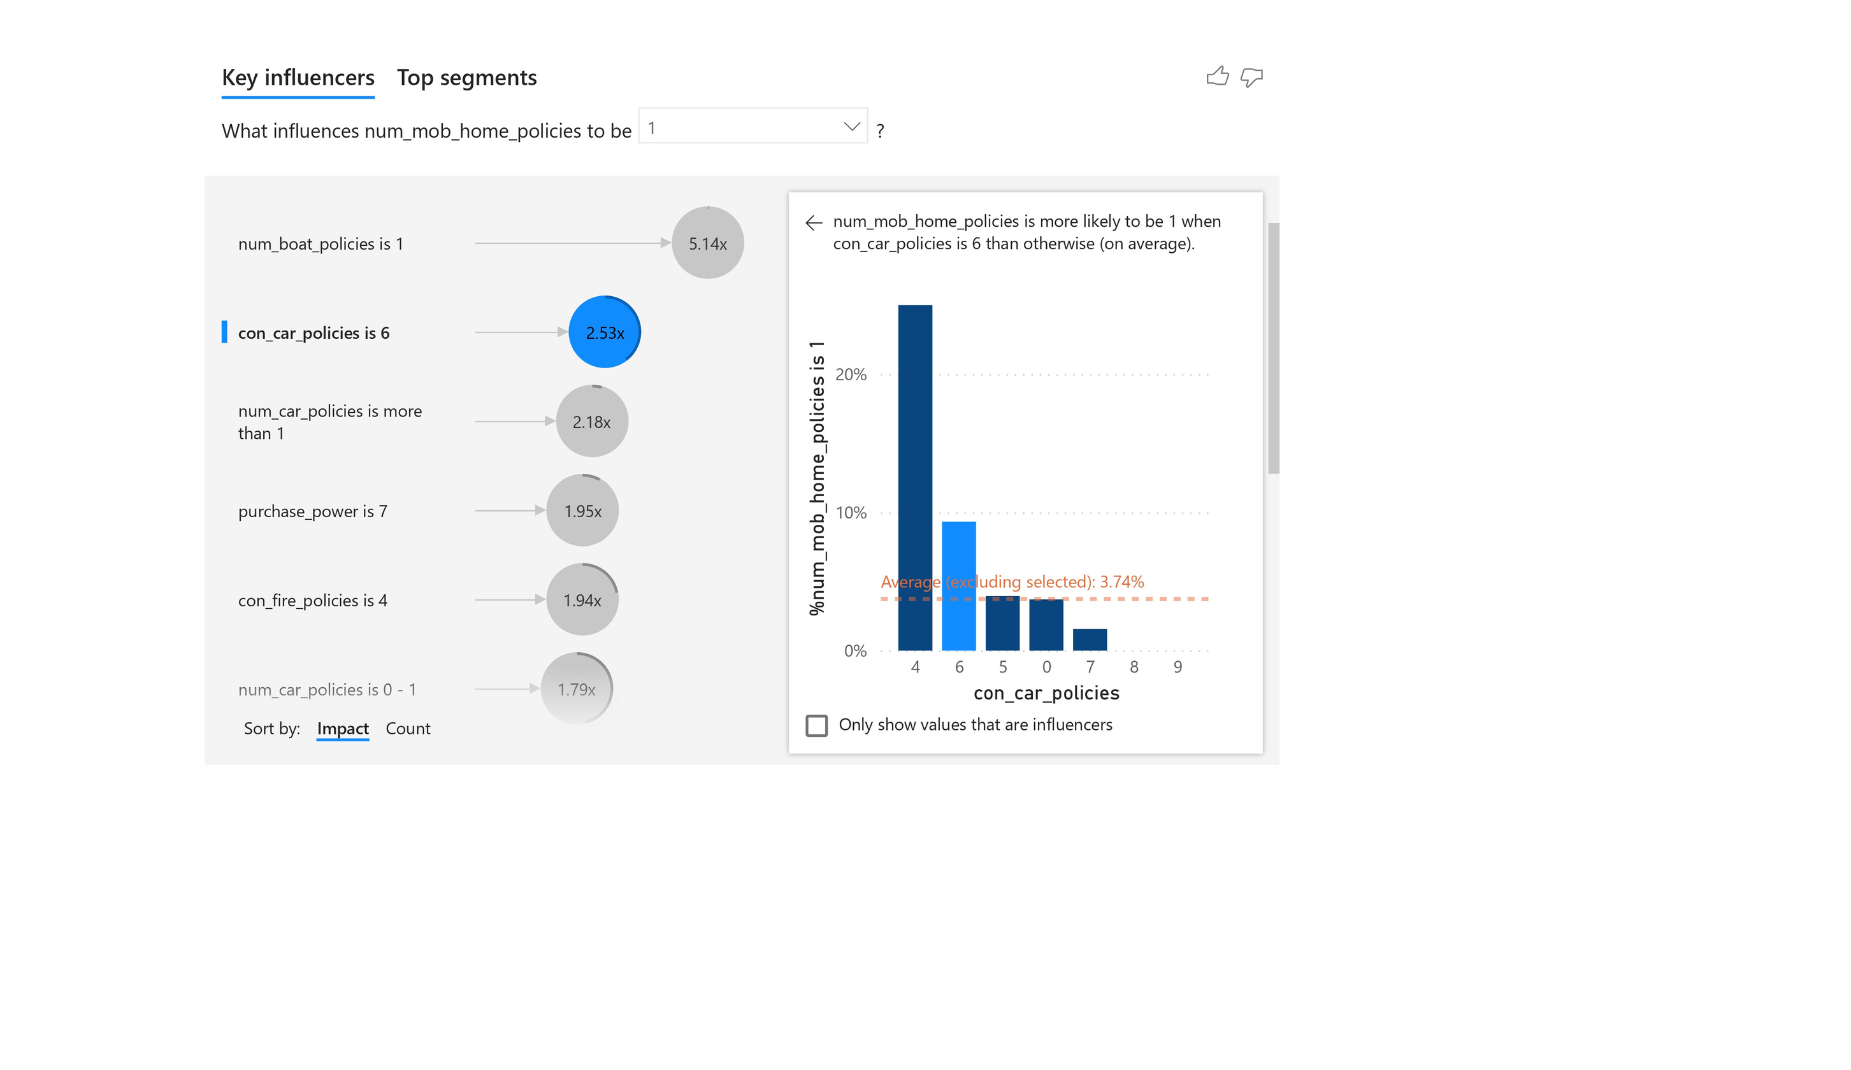
KEY INFLUENCER DIAGRAM 2

Slide 14
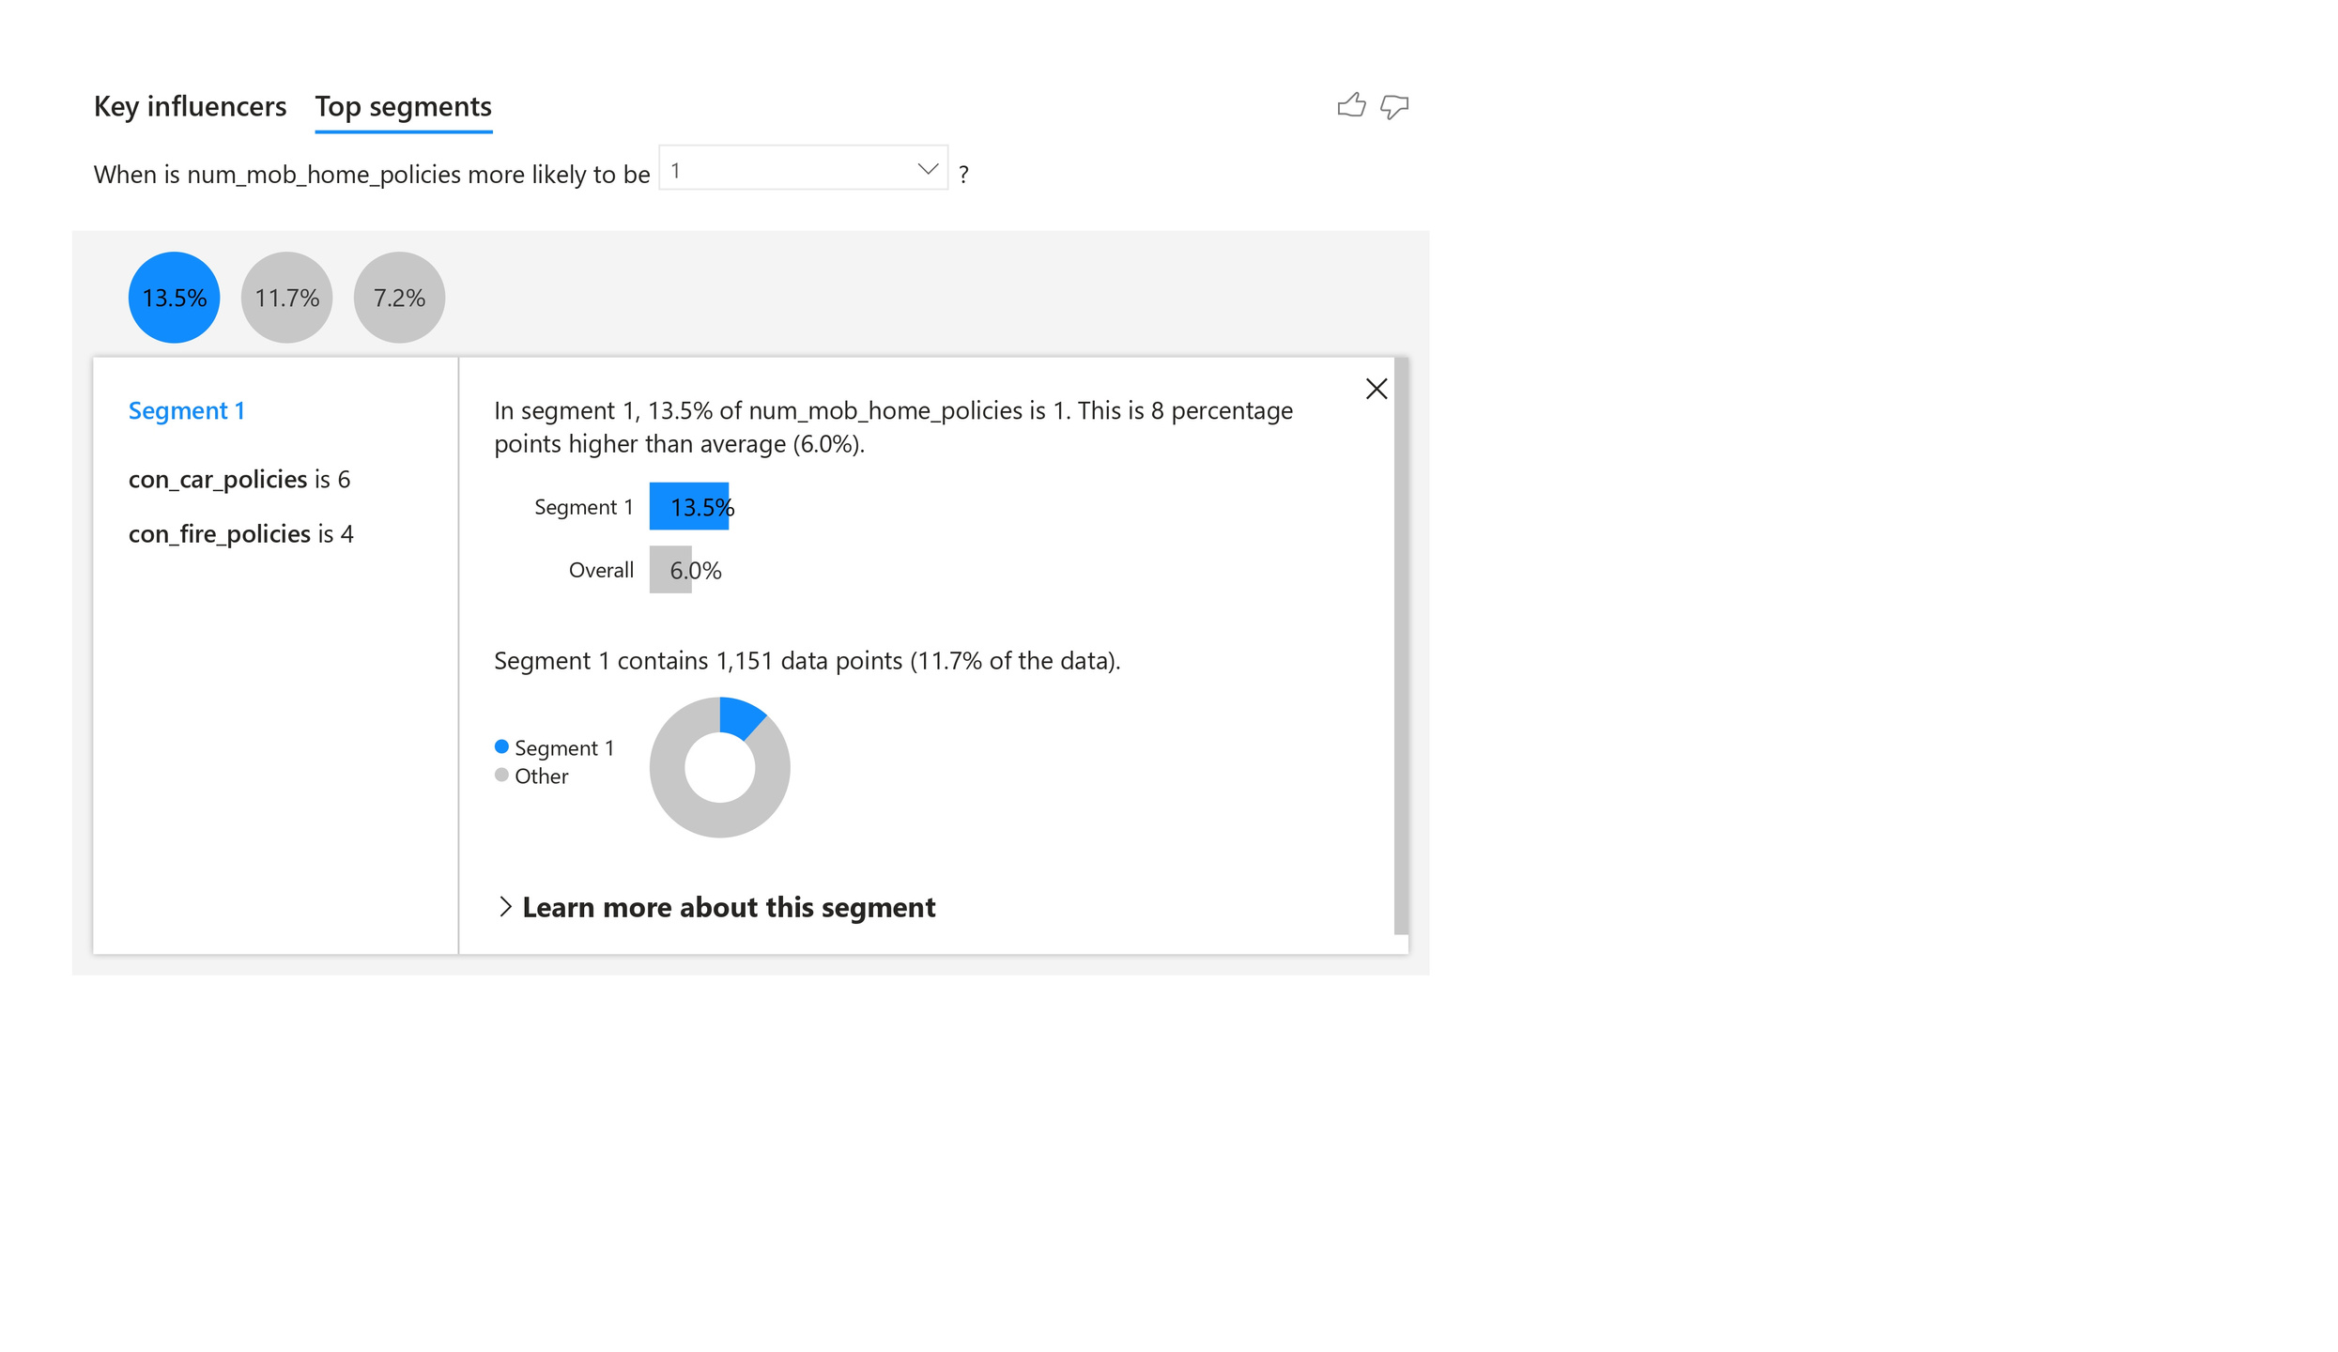
TOP SEGMENT 1

Slide 15
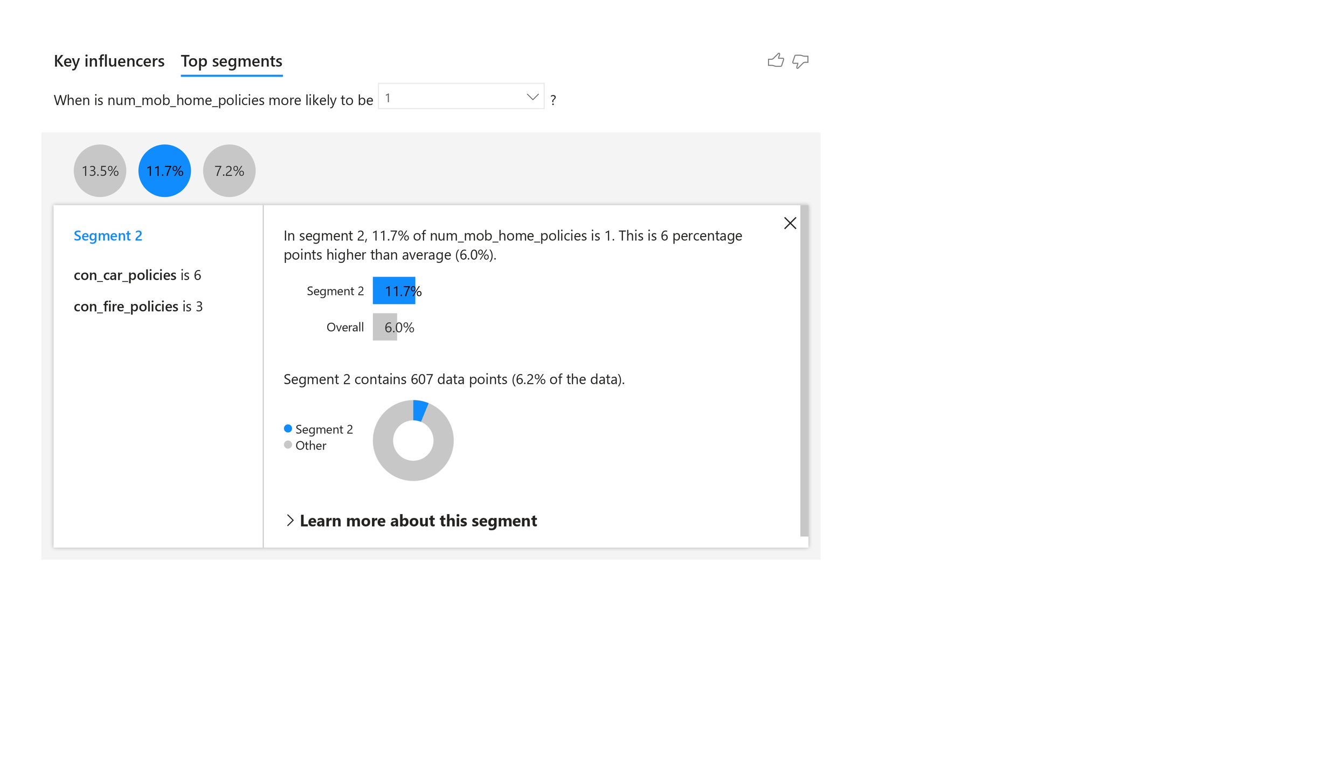
TOP SEGMENT 2

Slide 16
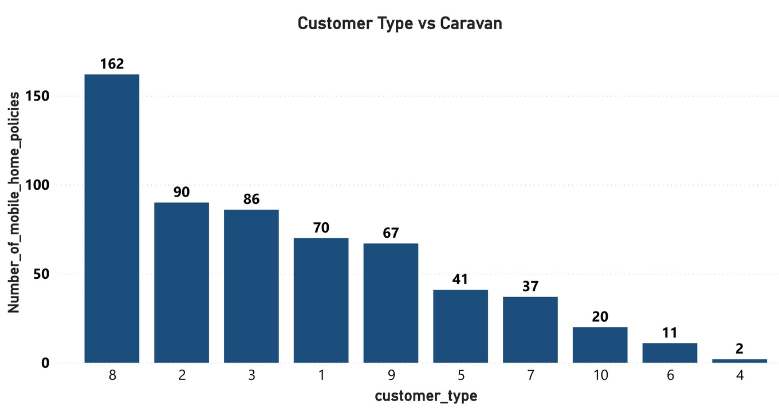
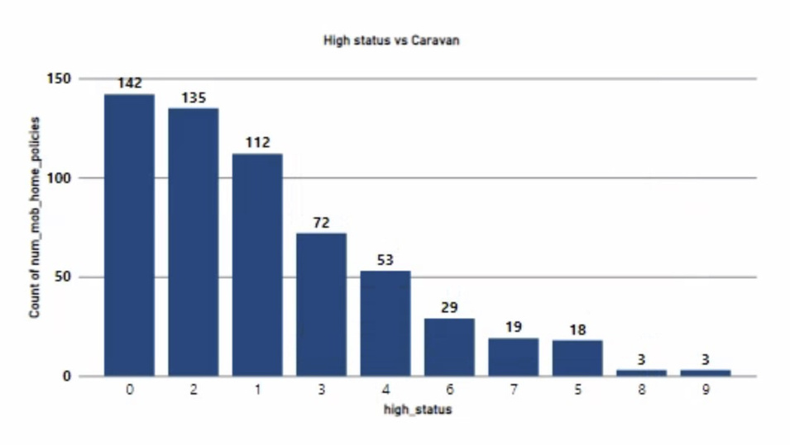
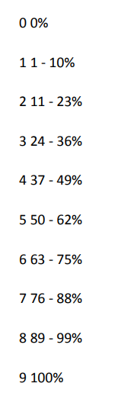
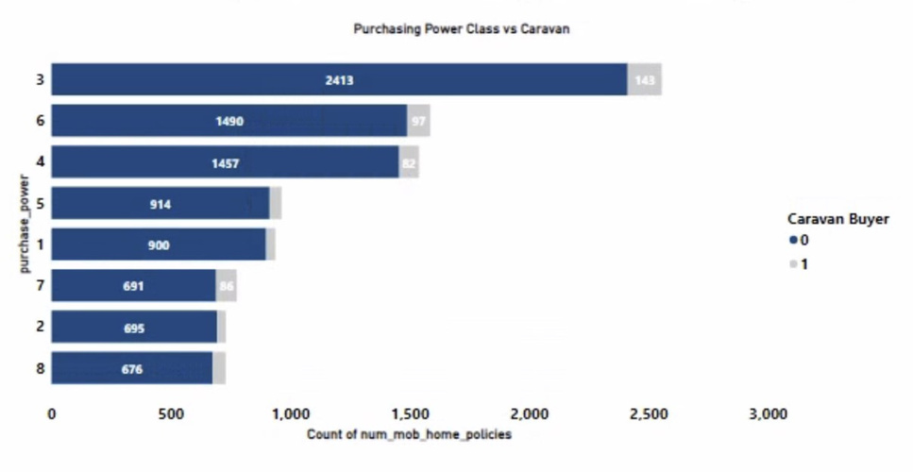
HISTOGRAMS
From the figure, it is clear that customer main type 8(Families with grown ups) has the highest number of caravan insurance buyers.
The graph indicates that, as the level of status increases, the number of people who are buying caravan insurance decreases.
The graph shows that customers having a purchasing power of 24% - 36% are more likely to purchase caravan insurance.

Slide 17
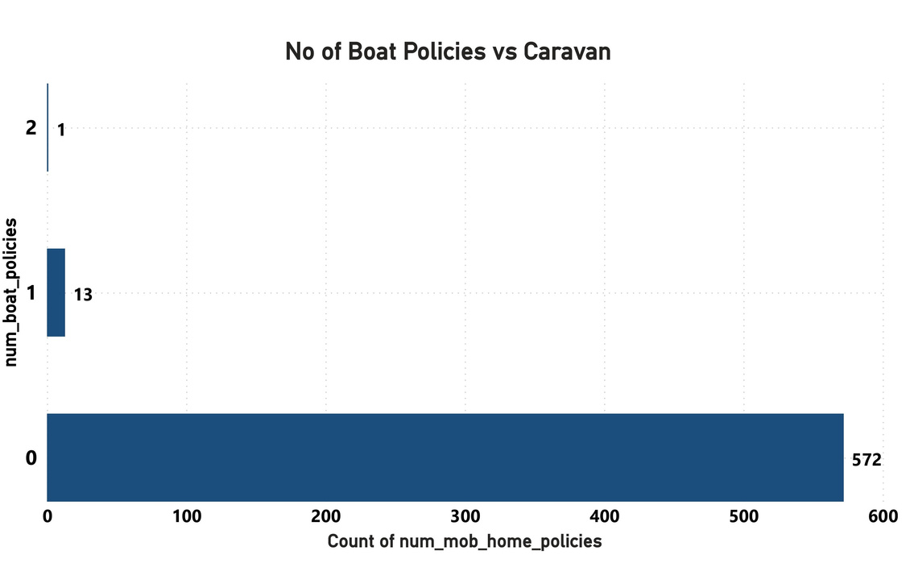
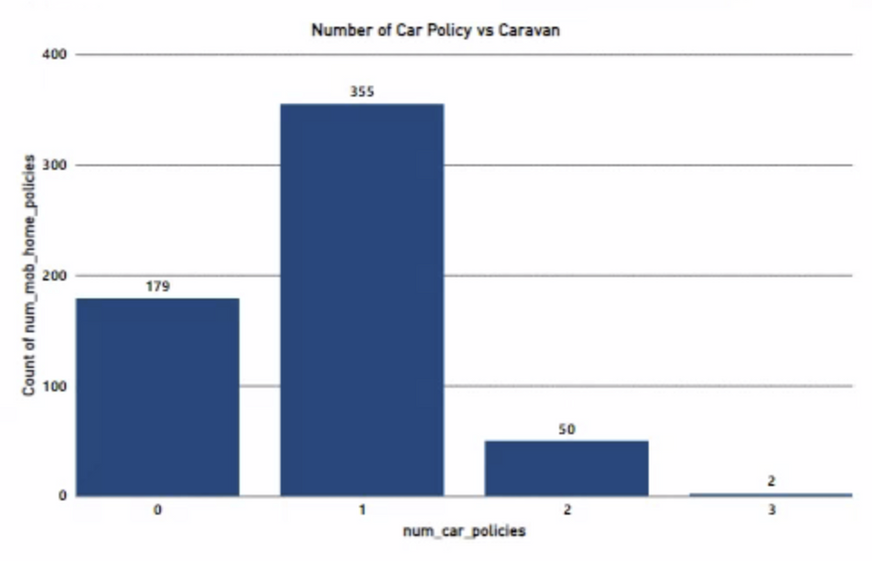
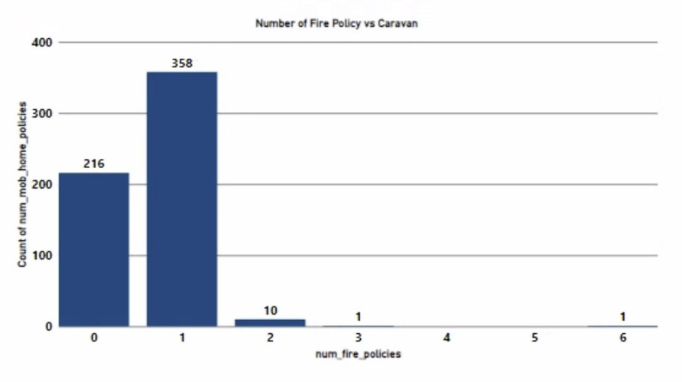
The chart explains that people who don’t have boat policies are more likely to buy caravan insurance policy.
From the figure, it is clear that people who have less than 3 car policies are purchasing caravan insurance policy. In particular, People who have 1 car policy are more likely to buy caravan insurance.
This graph demonstrates that customers purchasing caravan insurance are those with fewer than two fire policies. Additionally, the majority of those with a single fire policy purchased caravan insurance.

Slide 18

FEATURE SELECTION
Feature Selection refers to the process of choosing a subset of relevant features from a larger set of features. In datasets where there are numerous features, not all of them may contribute equally to the predictive power of a model, or be as informative. Some features may be irrelevant and may introduce noise. What Feature Selection tends to do is enhance the Interpretability of a model and improve model performance.
In this project, the features are selected based on the correlation scores and the insights derived from Exploratory Data Analysis (EDA).

Slide 19

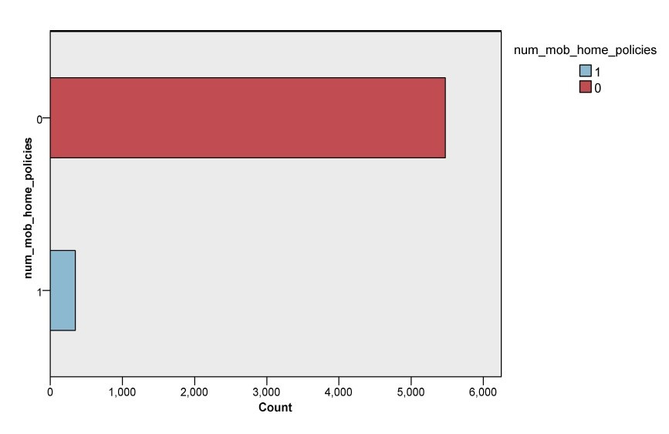

DATA BALANCE: CURRENT BALANCE
Caravan insurance dataset: 5% buyers, 95% non-buyers.
Accurate predictions can’t be produced in an imbalanced environment because algorithms may be biased toward the majority class.
To address the imbalance, a balance node is employed, involving over-sampling of the minority class.
This approach aims to create a more balanced dataset.

Slide 20
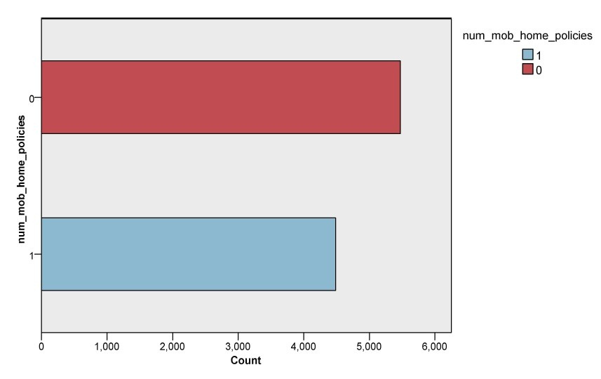
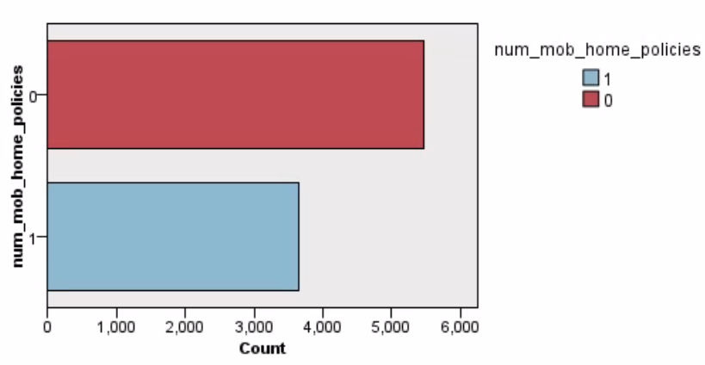
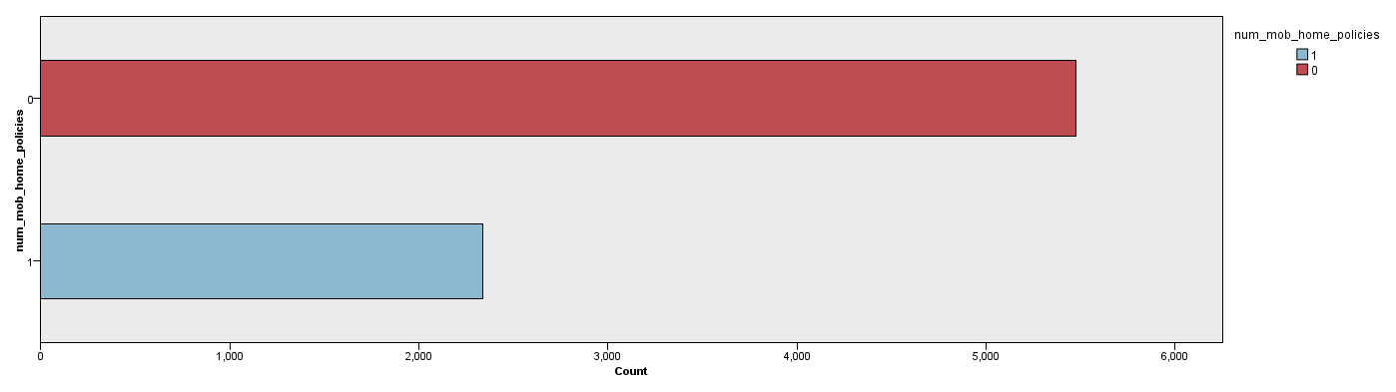
DATA BALANCE: USED BALANCE
55-45
60-40
70-30

Slide 21
ALGORITHMS USED
Under each of the data balancing proportions that were covered in the previous slide, four data mining algorithms were used to analyze the data and create a customer profile of the Caravan Insurance buyers.
The models used are:
C5
Random Tree
C&RT
Logistic Regression

Slide 22
PREDICTIONS
This will display the most precise models across three different ratios: 55%-45%, 60%-40%, and 70%-30%, to achieve optimal outcomes.

Slide 23
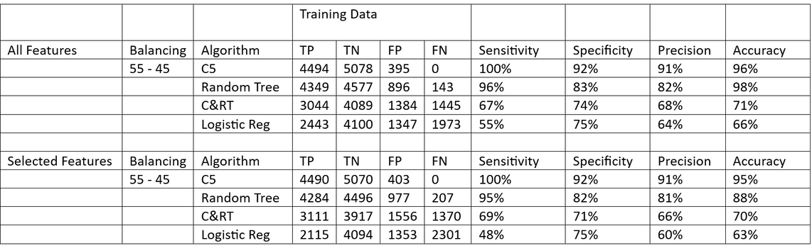
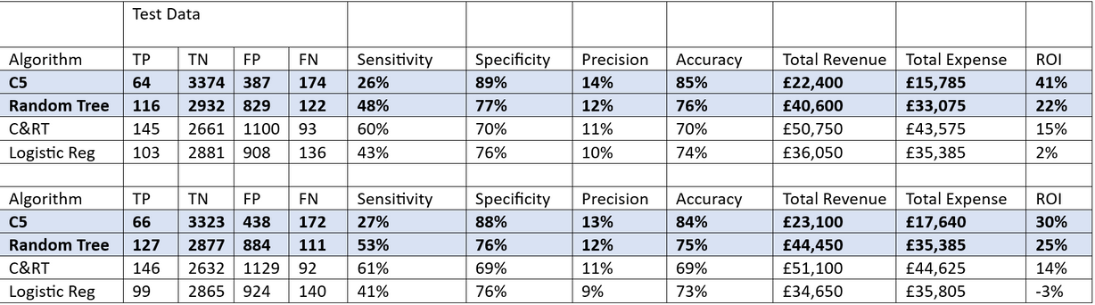
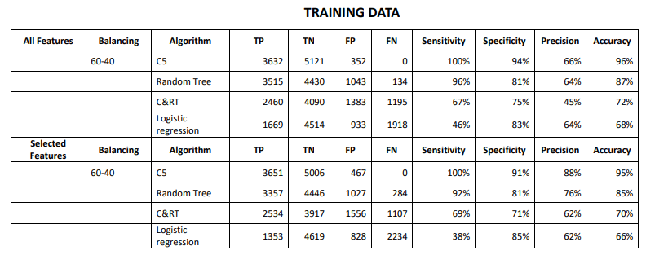
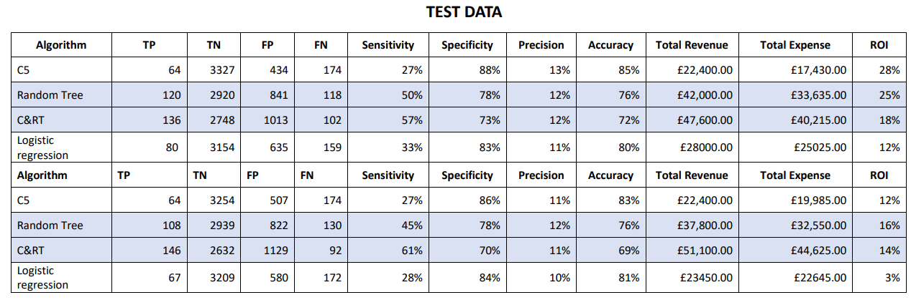
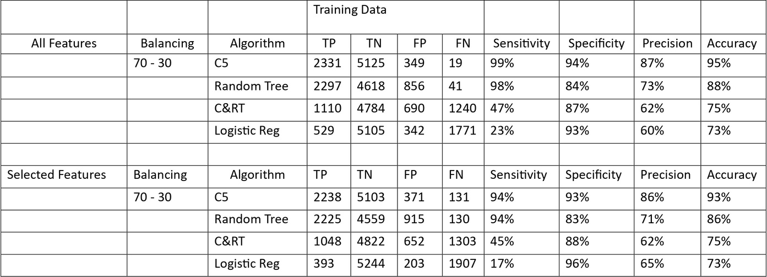
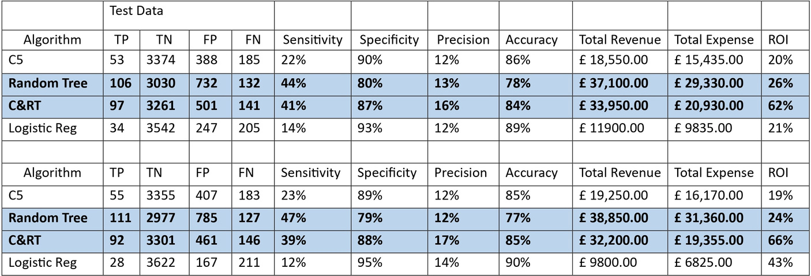
EVALUATION OF THE MODEL'S RESULTS

Slide 24
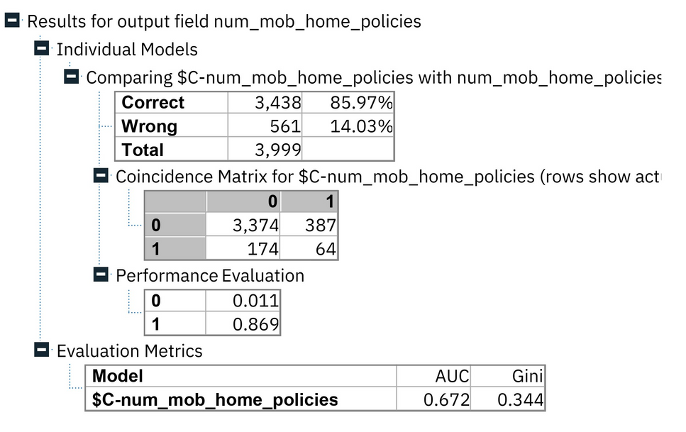
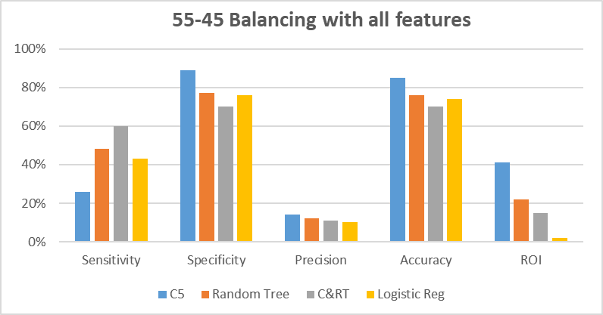
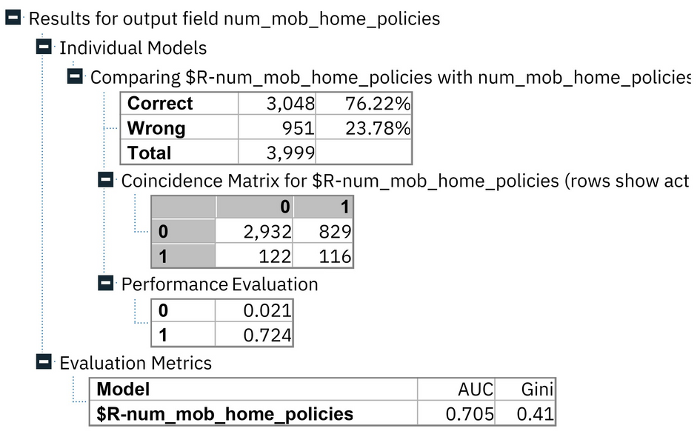
55-45 BALANCING WITH ALL FEATURES
C5
Random tree

Slide 25
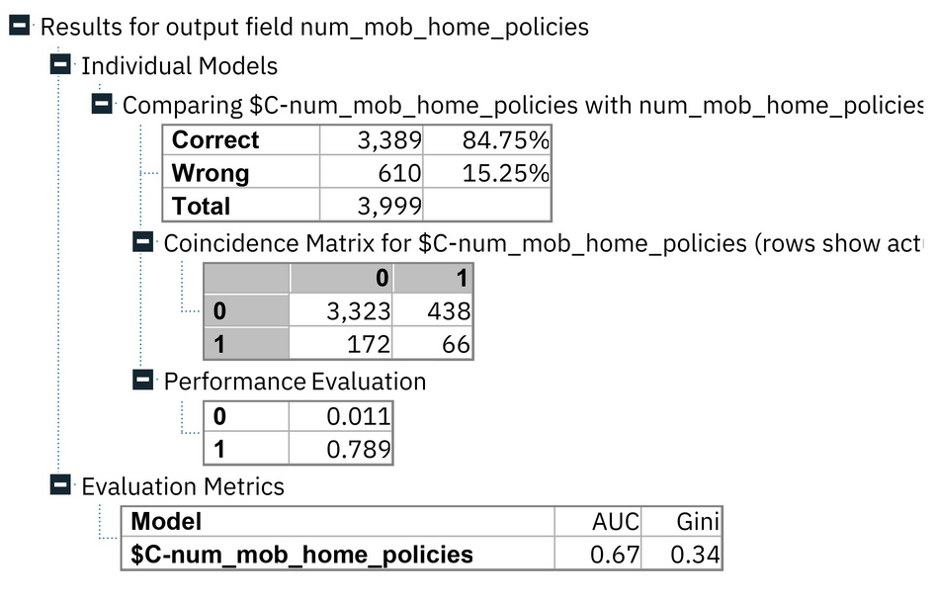
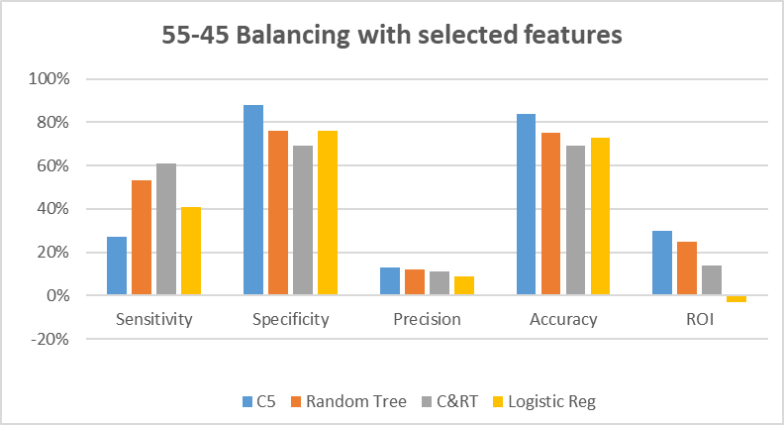
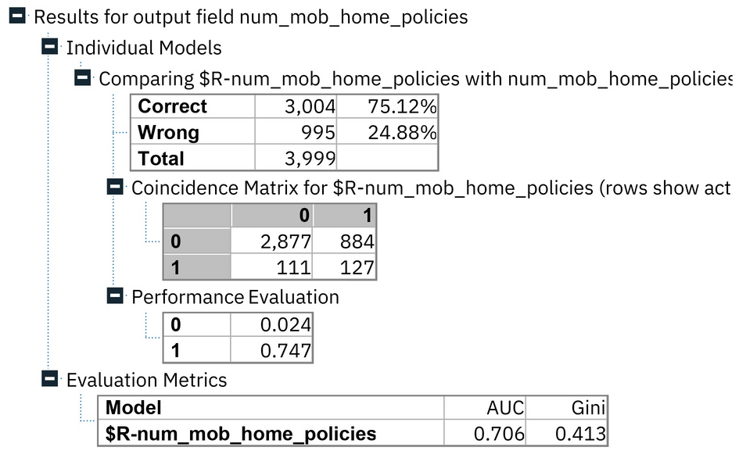
55-45 BALANCING WITH SELECTED FEATURES
C5
Random tree

Slide 26
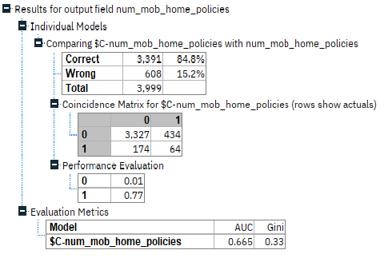
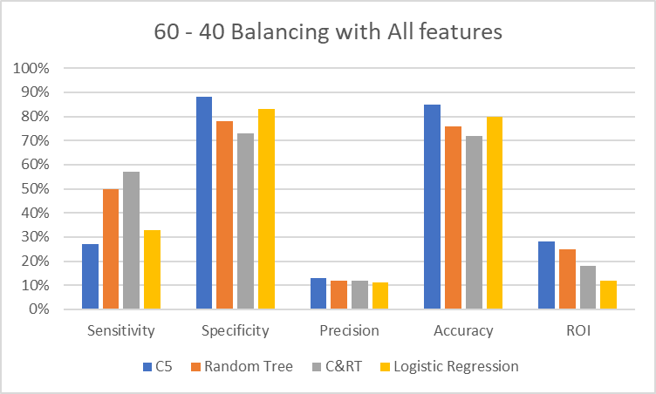
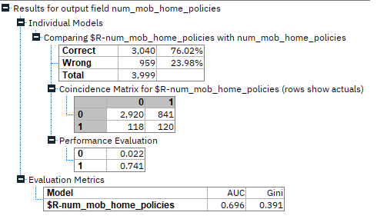
60-40 BALANCING WITH ALL FEATURES
C5
Random Tree

Slide 27
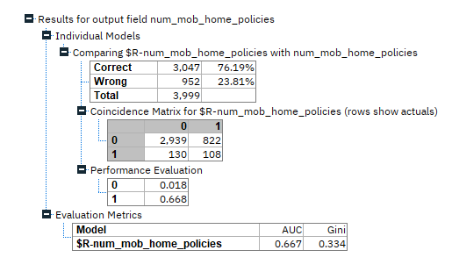
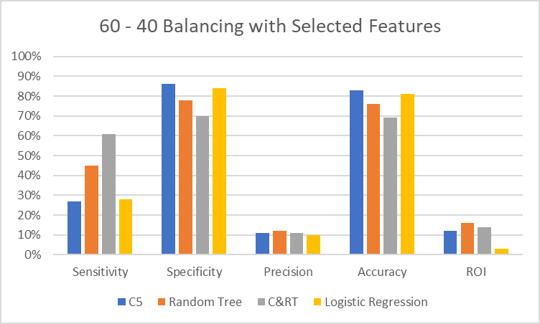
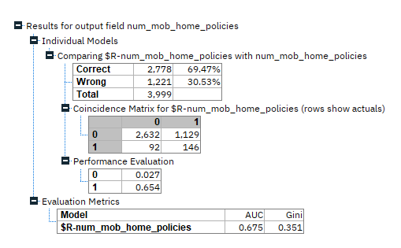
60-40 BALANCING WITH SELECTED FEATURES
Random tree
C&RT

Slide 28
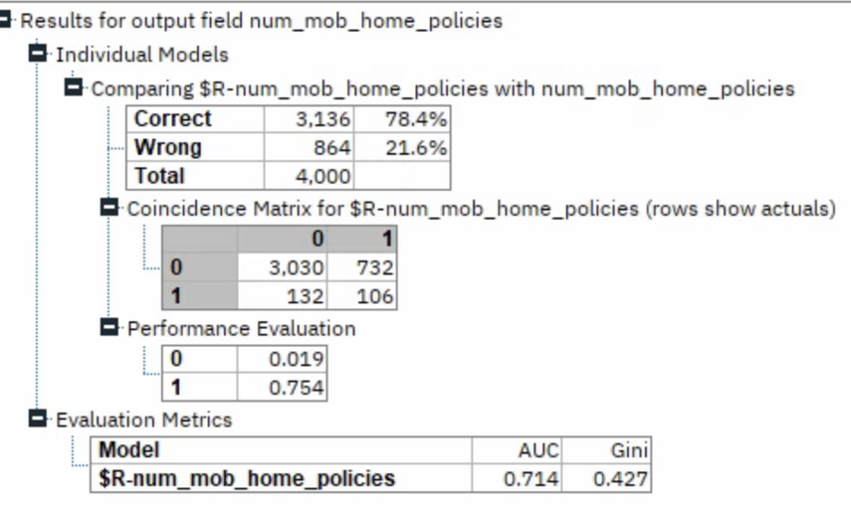
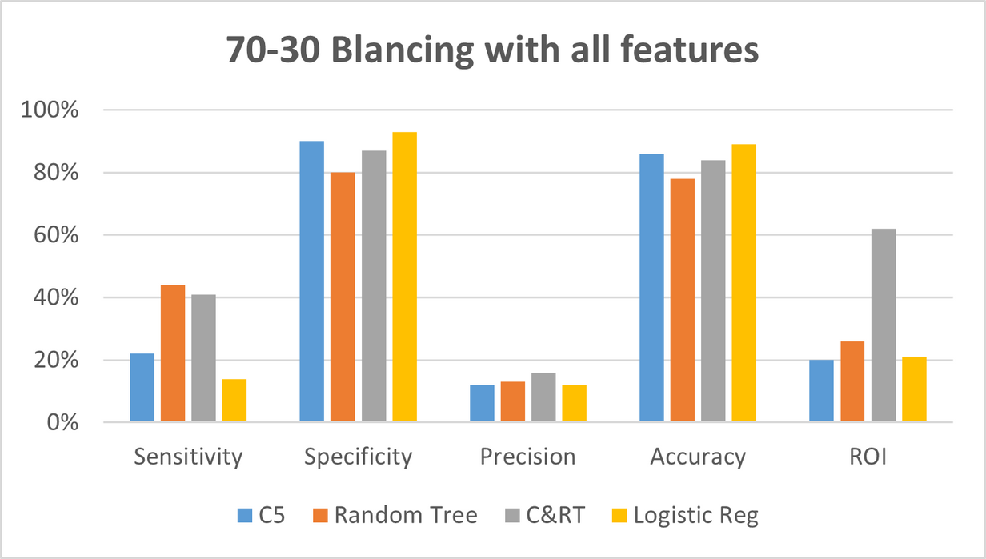
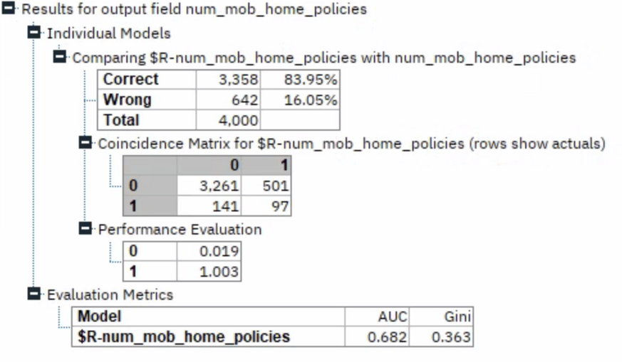
70-30 BALANCING WITH ALL FEATURES
Random tree
C&RT

Slide 29
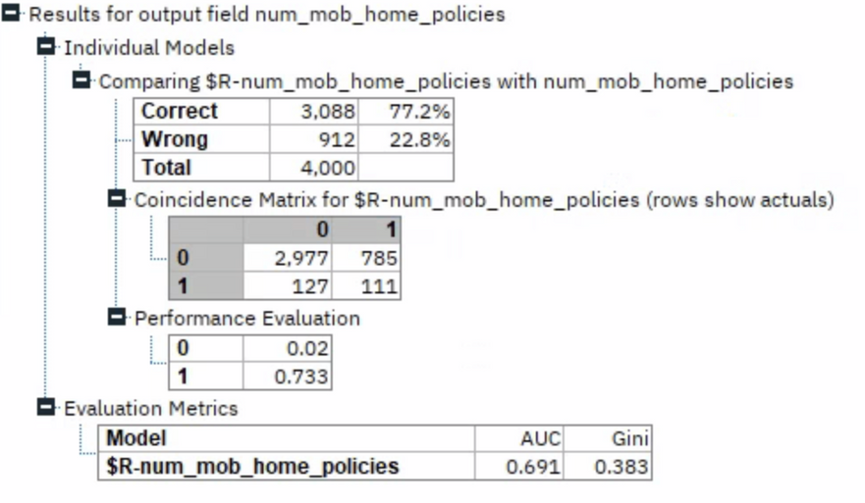
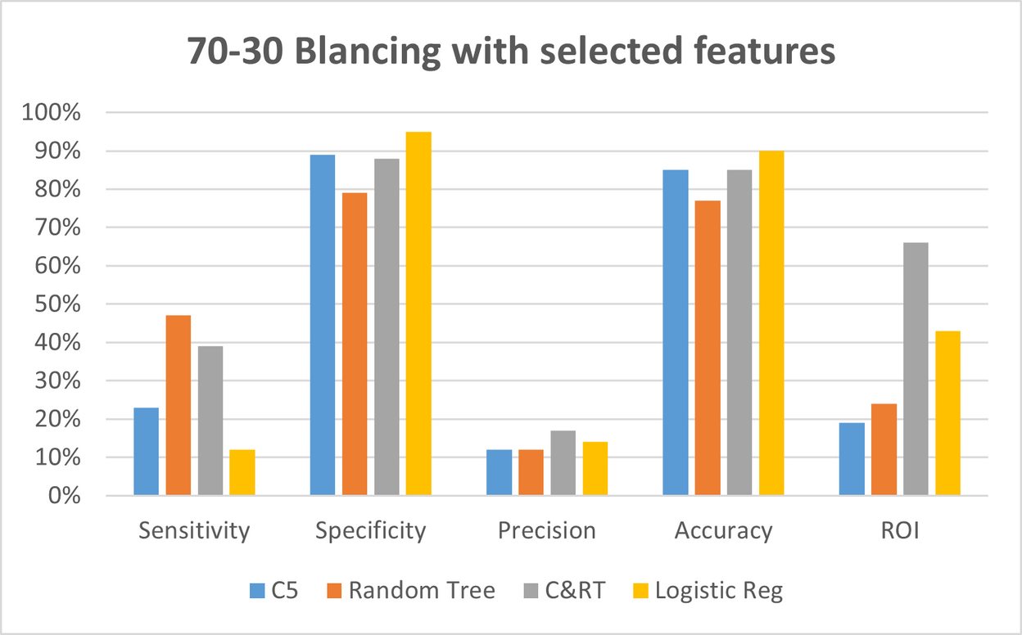

Random tree
70-30 BALANCING WITH SELECTED FEATURES
C&RT

Slide 30
ROI INTRODUCTION
CALCULATION OF ROI
ROI = (Total Revenue - Cost of Investment) / Cost of Investment
Total Revenue = (TP) * Cost of insurance
Total Expenditure = (TP+FP) * Cost of each customer acquisition
Cost of caravan policy(In UK) = £350 (Yurday, 2023)
Cost of each customer acquisition = 10% of cost of caravan policy
ROI Analysis or Return On Investment Analysis is a useful technique that helps us evaluate the efficiency and financial success of our analytics efforts. It generally expressed as a percentage. In simple words, the higher ROI means the investment been made is profitable; the lesser ROI value indicates that the investment been made is less profitable. Businesses frequently use ROI to assess the possible returns of various potential investments and it helps them to determine the best way to use their resources.

Slide 31

CUSTOMER PROFILE

Slide 32
RECOMMMENDATIONS
By utilizing the outcomes of the models and with more precise target segments, the marketing team can launch campaigns. They offer the potential for a higher return on investment. Given that the cost of gaining a customer in this caravan insurance instance is quite low (10% of the cost), management may choose to prioritize the model that generates the highest number of actual customers (True positives), even if it also results in a significant number of False positives. A possible approach is to choose the model that has the greatest sensitivity and return on investment (ROI) while adopting a cautious investment strategy.

Slide 33
REFERENCE
Yurday, E. (2023) Average cost of Caravan Insurance 2023, NimbleFins. Available at: https://www.nimblefins.co.uk/average-cost-caravan-insurance-touring-static (Accessed: 06 December 2023).
IBM. (n.d.). IBM SPSS Decision Tree. Available at: https://www.ibm.com/uk-en/products/spss-decision-trees
R. J. Brachman and T. Anand. "The process of knowledge discovery in databases: A human-centered approach." In U. Fayyad, G. Piatetsky-Shapiro, P. Smyth, and R. Uthurusamy, editors, Advances in Knowledge Discovery and Data Mining. AAAI Press, Menlo Park, 1995
U. Fayyad, G. Piatetsky-Shapiro, and P. Smyth. "Knowledge discovery and data mining: Towards a unifying framework." In Simoudis et al. [24]

Slide 34






OUR TEAM
Claudia Alves
Eldhose Varghese
Laura Méndez del Pino
Divyadharshini
Sundaram
Nana Nkansah

Slide 35

Thank You

Slide 36

APPENDIX
Your paragraph text
R CODE FOR INVESTIGATING HEATMAPS AND CORRELATION COEFFICIENTS OF THE TOP 20 IMPORTANT ATTRIBUTES WITH THE NUMBER OF MOBILE HOME POLICIES.

Slide 37



2.HISTOGRAMS
2.1 Car Ownership

Slide 38




2.2 Religious Status

Slide 39


2.3 Income Levels

Slide 40


2.3.1 - Income Levels

Slide 41


2.4 Contributions of car and fire policies

Slide 42


2.5 Home owners & Rented house

Slide 43


2.6 Married & High level education

Slide 44


2.7 Unskilled labourers & Household with children

Slide 45

2.8 Different Age Groups

Slide 46

3. 55-45 BALANCING WITH ALL FEATURES AND SELECTED FEATURES

Slide 47

3.1 60 - 40 BALANCING WITH ALL FEATURES AND SELECTED FEATURES

Slide 48

3.2 70-30 BALANCING WITH ALL FEATURES AND SELECTED FEATURES

Slide 49


4. R CODE FOR LOGISTIC REGRESSION MODEL
70-30 Balancing with all features and selected features

Slide 50


4.1 R CODE FOR LOGISTIC REGRESSION MODEL CONTINUED

Slide 51


4.2 R CODE FOR LOGISTIC REGRESSION MODEL CONTINUED

